Slide 1


W03-Prove : Submit Module #1
By Marco Varela
Project created on 3/31/2021

Slide 2
MODULE 1 Database
The individual module will be divided in the following sections
01
BYU-Idaho Catalog Database
Topic, Schema, Tables, Entities, Attributes, Datatypes, Relationships, Keys
02
Populating with Data
Insert Statements
03
Delete and Update Statements
04
Joins Between Tables
Stretch Challenge 1
05
Aggregate Functions
Stretch Challenge 2
06
Filtering by DATE/ YEAR
Stretch Challenge 3

Slide 3

Marco Varela
01
Project Explanation

Slide 4
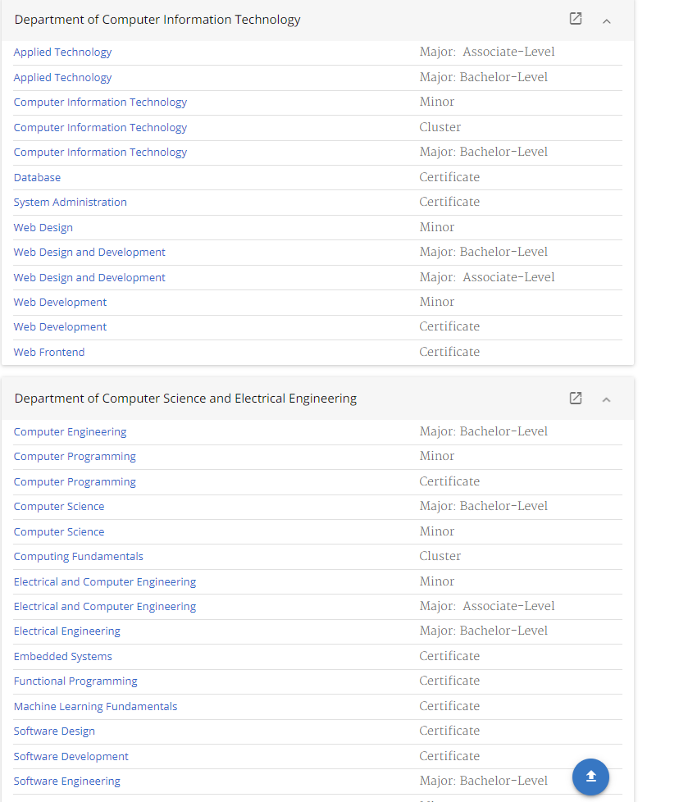
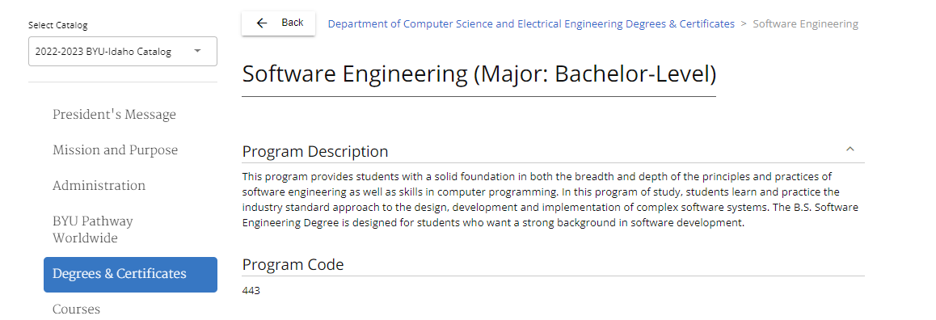
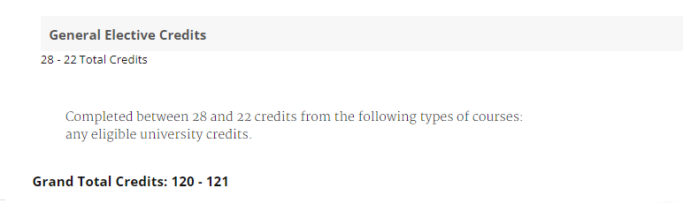
I will collect from the BYUI catalog:
Departments
Fields
Program type
Program Code
Grand Total Credits
I will collect from the student:
Full name
Contact Information
Address
https://www.byui.edu/catalog#/programs

Slide 5
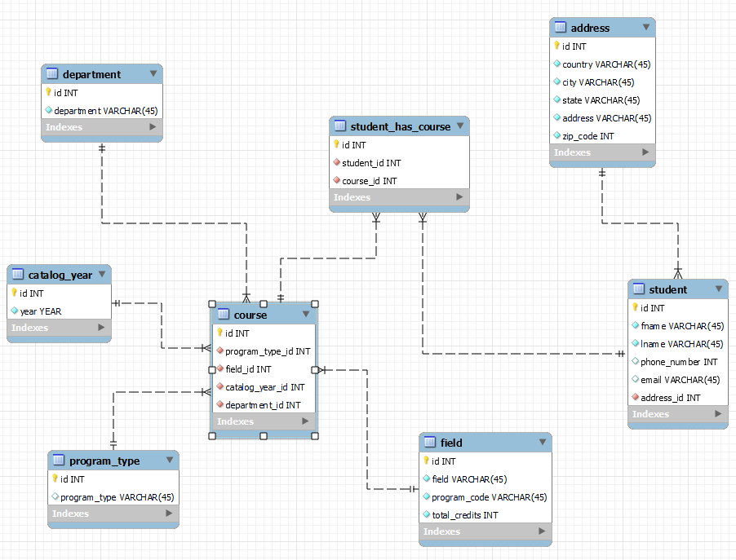

I will be using MySQL Workbench as my DBMS
(Database Management System)
My Diagram

Slide 6

Marco Varela
02
POPULATING WITH DATA

Slide 7
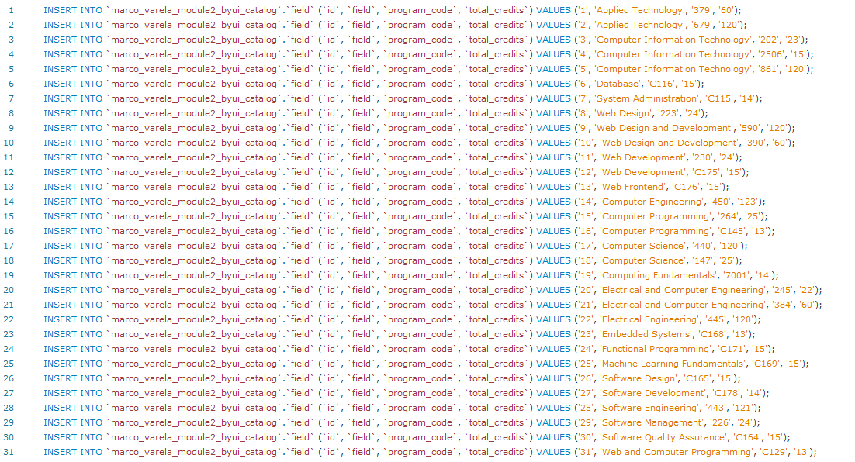
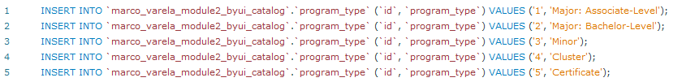
Field table
Program type table
Catalog year table
Department table
Course (The table putting everything together)
Catalog related inserts

Slide 8
Student’s Information
Student’s Addresses
Student related Inserts

Slide 9

Marco Varela
03
Delete and Update Statements

Slide 10
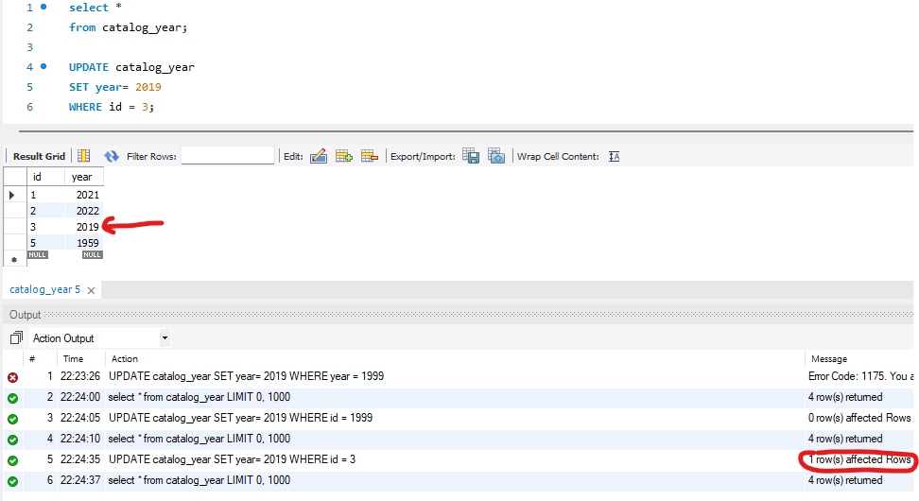
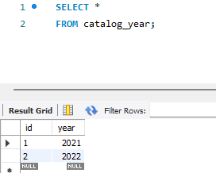
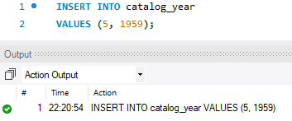
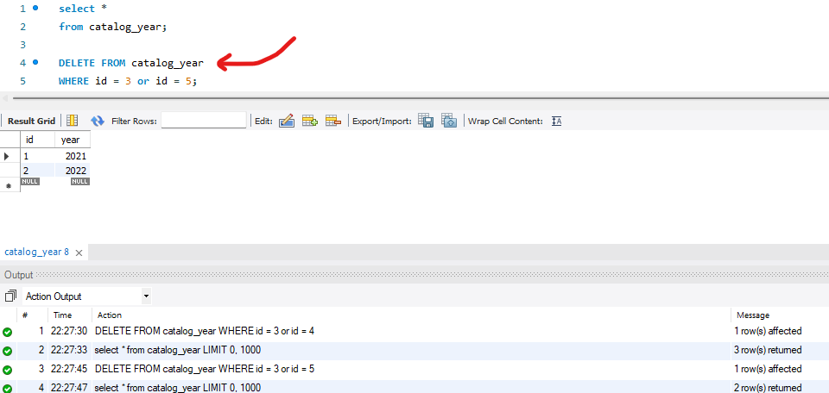
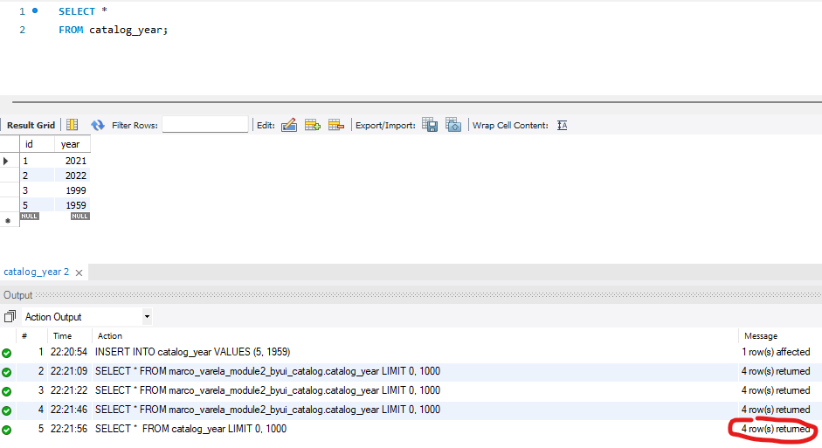
Update statement
Insert statement
Delete statement
Insert, Update and Delete Statements

Slide 11
Marco Varela
04
Joins Between Tables

Slide 12
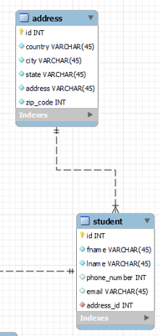
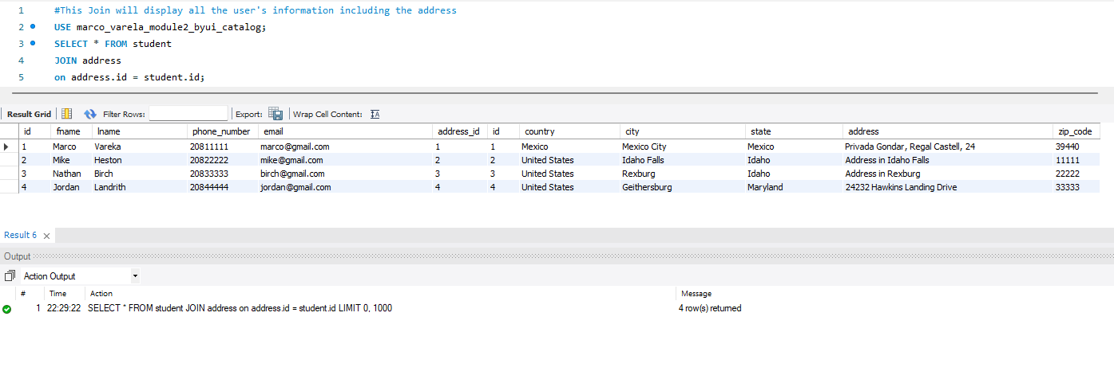
Joining the student and address tables

Slide 13
Marco Varela
05
Aggregate Functions

Slide 14

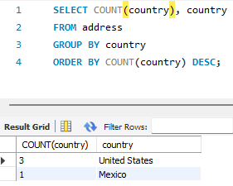
How many students do we have per country?
How many students do we have from USA?

Slide 15
Marco Varela
06
Filtering by DATE/YEAR

Slide 16
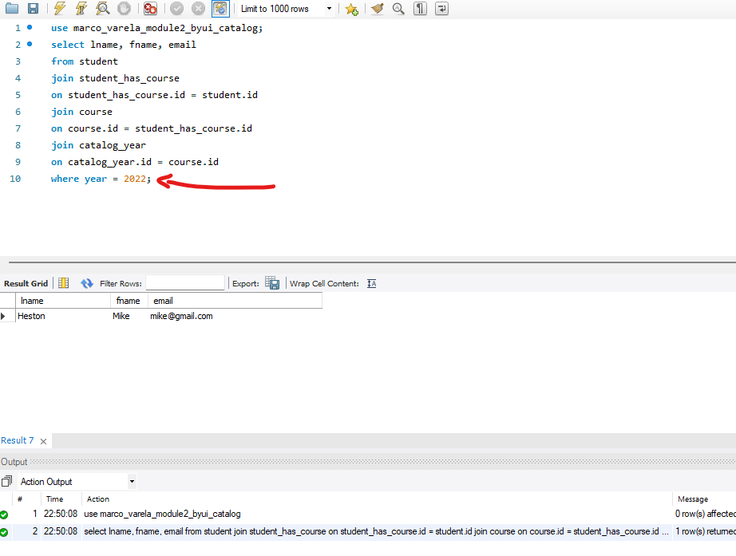
Who is studying with the 2022 catalog?
Filtering by year

Slide 17
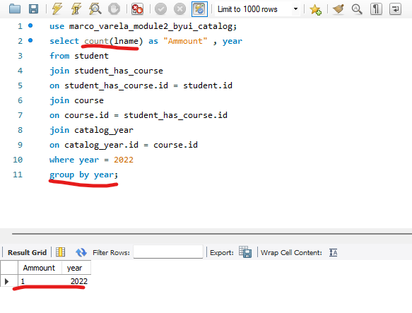
Who is studying with the 2022 catalog?
Filtering by year using aggregate functions

Slide 18

Thank You Brother Birch
Module 1 – Applied Programming

